Slide 1

Problem Statement
My wife and I are buying a new home.
We don’t want to give our email address to a website like Zillow to be able to save houses we are interested in.

Slide 2
Project Requirements
We need to save houses during our search so we can discuss them later.
We need to be able to save houses we select to a file that we can send to our realtor to schedule showings.
We need to be able to save a picture of each house so we can tell them apart.
We need to be able to see the house on a map, so we know where it is.
We need to be able to see the houses each of us has saved in our own list as well as a combined list that contains all the houses.
We need to be able to add new users that can save their own houses.
We need to be able to filter the combined list by different criteria like price or area.

Slide 3
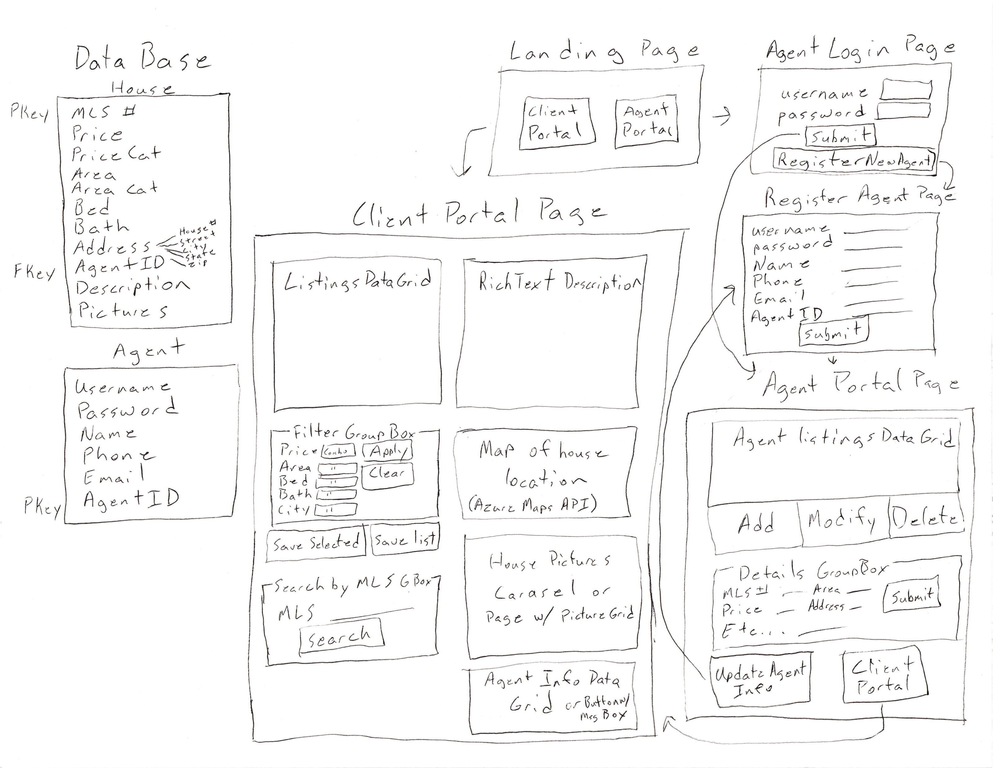
Initial Design

